Slide 1
A SURVEY OF CONTEMPORARY Fashion recommendation Systems (RS)
ALEXIS BRYAN AMBRIZ
A SHORT STORY PRESENTATION FOR CMPE 258

Slide 2

THE review PAPER
I am summarizing a research review paper in this short story presentation written by authors having a variety of industry, academic, and cultural backgrounds.
The goal of the authors as stated in their abstract is to “identify the most pressing challenges in fashion RS [Recommendation Systems] research […] (and) the most important evaluation goals and perspectives […] and the most commonly used datasets and evaluation metrics.”
For example, over 50 research papers on fashion recommendation systems were reviewed and many were collected and included in the paper. All of these papers were sourced from the same bibliographic database on computer science research, (DBLP).
Many of the papers were published from 2014-2023, so many of the model architectures might be in use today or being improved on currently!

Slide 3
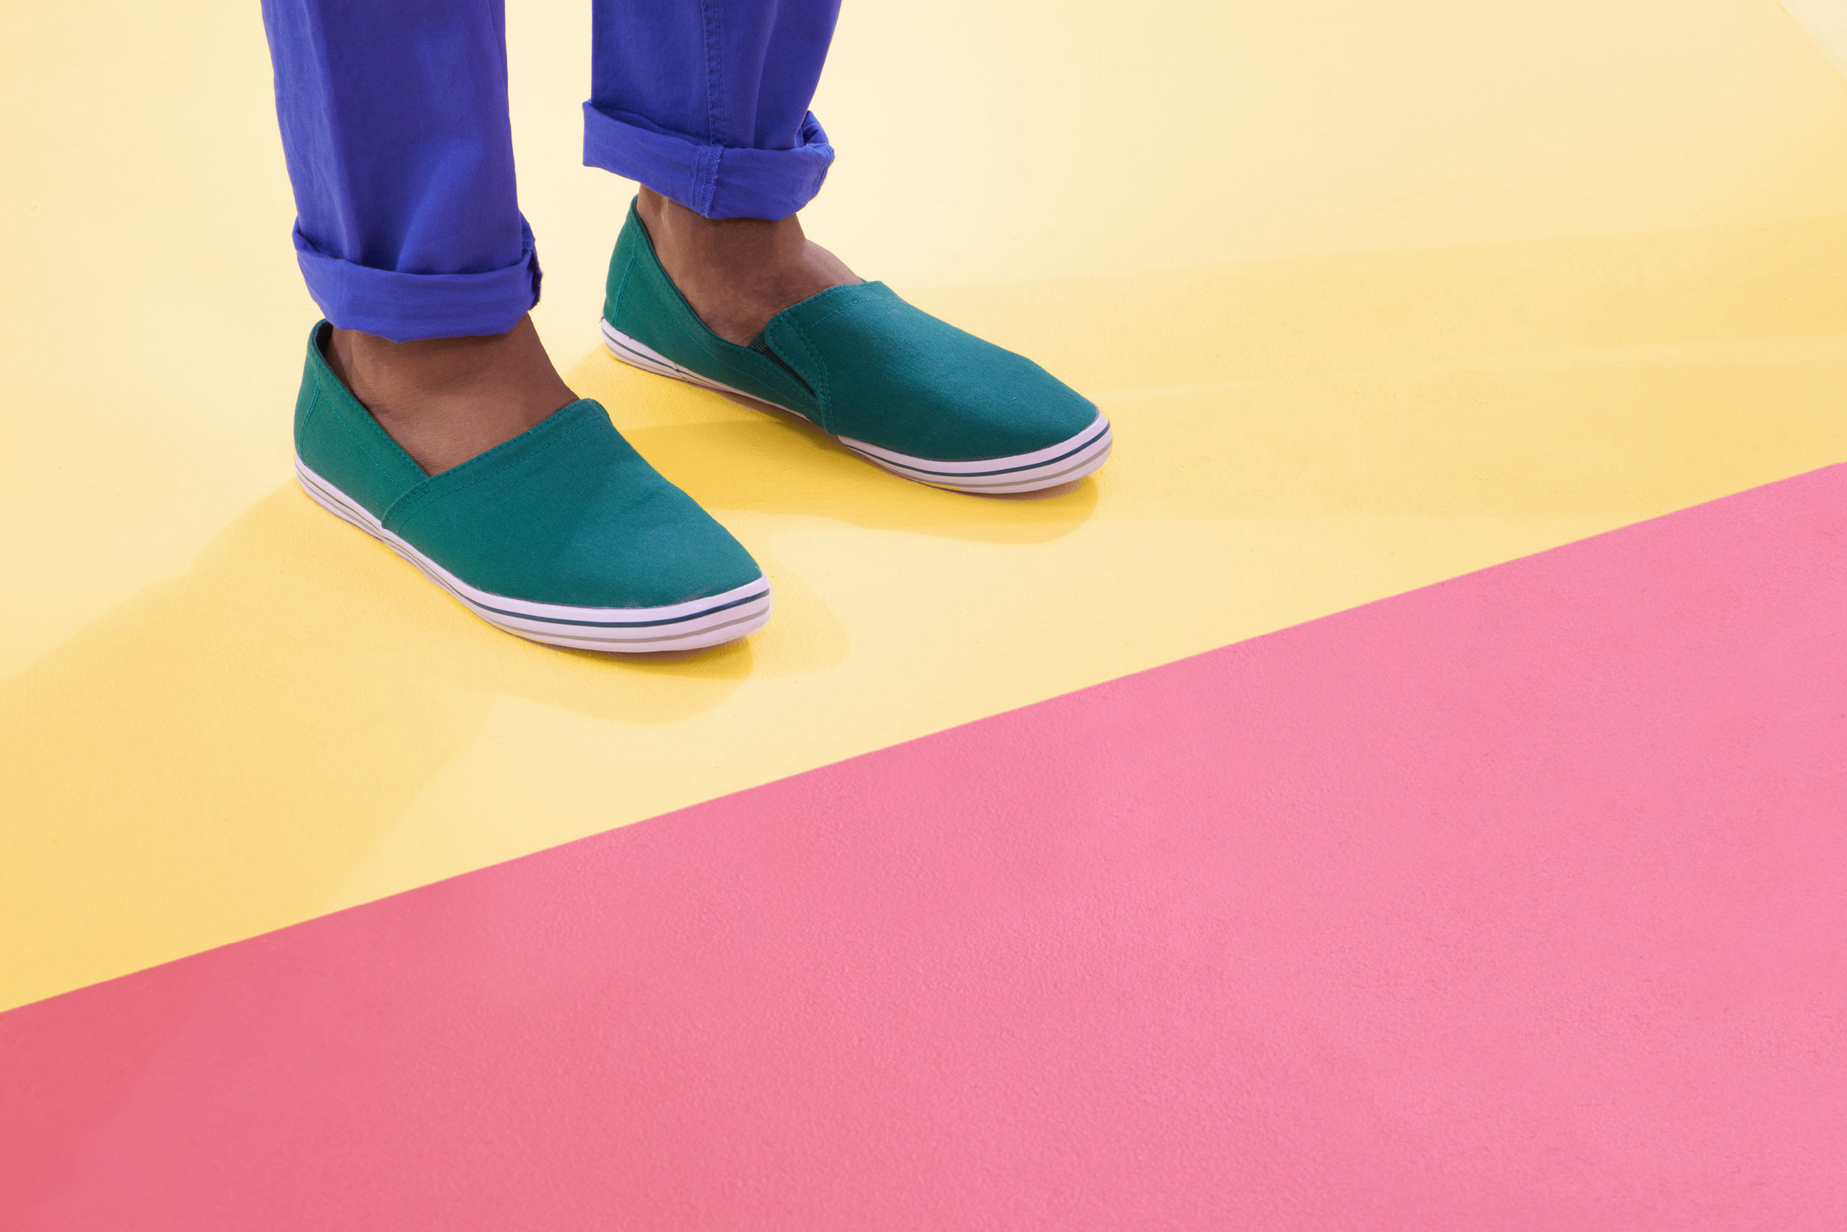
FASHION RECOMMENDER SYSTEMS BY TASKS AND DATA INPUT
The authors were able to discover 5 main tasks and 3 main data input types that most of the recommendation systems they reviewed may fall under.

Slide 4
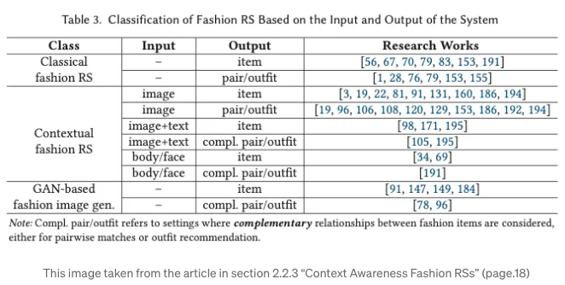

Slide 5
THE 5 MAIN FASHION RS TASKS
The authors were able to discover 5 main tasks that the recommendation systems could be classified into:
Fashion item recommendation systems (data may be based on user past purchases a.k.a. U-I [User-Item] feedback)
Fashion pair and outfit recommendation systems (data may be based on how similar & complementary items are to each other)
Size recommendation systems (data may be based on U-I feedback &/or physical measurement questionnaires)
Learning explanations for fashion recommendation systems (data may be based on combining tabular and/or image based explanations of machine learning techniques & neural network recommendations)
Systems for other fashion prediction tasks

Slide 6


Slide 7
The 3 main fashion rs input data
They also further classified the recommendation systems based on 3 types of data used as input by the RS to create the recommendations:
RS with data based on user past purchases a.k.a. U-I (User-Item) feedback
RS with data based on U-I & Side Information (more information about the user category like gender or age relation to the items brand/color/texture, etc.)
RS with data based on CA (Context Awareness such as spatial-temporal or computational environment, multi-media queries, physiological measurements, and information about the users affect or mood)

Slide 8
THE CHALLENGES IN BUILDING A MODERN RECOMMENDATION SYSTEM FOR FASHION

Slide 9

side-note:
As there are 5 main abstract tasks and 3 main abstract data type classifications, this implies that there are many combinations of challenges to take into account when considering in implementing a modern recommendation system.
In this presentation, I only go over a few examples that were especially emphasized within the paper.

Slide 10
USER-TO-ITEM RECOMMENDATION SYSTEMS
Major Challenge: Predicting the Sizing/Fit of garments for users.
Tabular Systems
A noted solution mentioned by the authors involves shipping users clothing recommendations before they commit to purchase to try on as part of a clothing subscription service.
However, the issue they mentioned arises from a clothing subscription service is it suffers from a lack of data when a user starts the subscription (a.k.a. the 'cold start' issue)
User's receiving negative recommendations do not tend to continue purchasing their subscription - leading to a lack of user feedback to the model.
Computer Vision Systems
A solution involving image data involves recreating the experience of trying on clothes in an online environment (in augmented or virtual reality), which may be a lower cost solution than the clothing subscription service.
It can help solve the cold start issue by contributing valuable user feedback via virtual body measurement information
Users will be able to try-on clothing before purchase without paying for the subscription increasing the amount of measurement data

Slide 11


Slide 12
ITEM-TO-ITEM RECOMMENDATION SYSTEMS
Major Challenge: Fashion Item Compatibility & Recommending ‘Complete Outfits’
Tabular Systems
According to the authors, including tabular data features such as social group preferences, trends, and location can help improve item-to-item compatibility prediction.
Specifically, matching an item to a style before crafting a ‘complete outfit’ via a FITB (Fill-in-the-Blank) prediction algorithm that iteratively predicts the next garment in the outfit.
Computer Vision Systems
In the realm of fashion item compatibility and complete outfit recommendation, including images can help via object detection and localization for determining the attributes of certain items and finding similarities between them.
Computer vision recommendation systems can help improve item recommendation when dealing with users having limited previous purchase data as it only requires having a sufficiently large catalogue.
Adding additional data extracted from images to the tabular dataset before matching item to a style and crafting a complete outfit can improve the model performance.

Slide 13
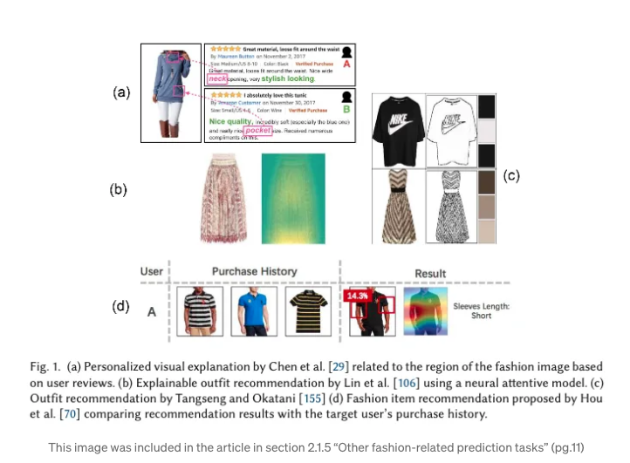
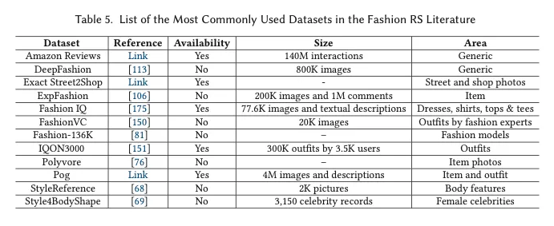
SYSTEMS THAT LEARN EXPLANATIONS OF RECOMMENDATIONS
The authors delved into how most research articles currently do not take into account business metrics in the evaluation of the recommender systems.
They mentioned that model performance can be subjective based on the perspective taken.
In my perspective, a model recommending fashion should include human feedback and retraining and explain how the recommendations are being made continuously.

Slide 14
CONCLUSION AND FINAL THOUGHTS
The datasets chosen by many researchers to train fashion recommender systems are usually sourced from a combination of social media influencers, high fashion street photography images, and blogs of well-known designers.
Using these sources to train a model could reinforce societal biases by training a model to learn a glamorized version of style that is used to commonly advertise clothing, so users should be aware of the recommendations and take an active role when making purchases online.

